Slide 1
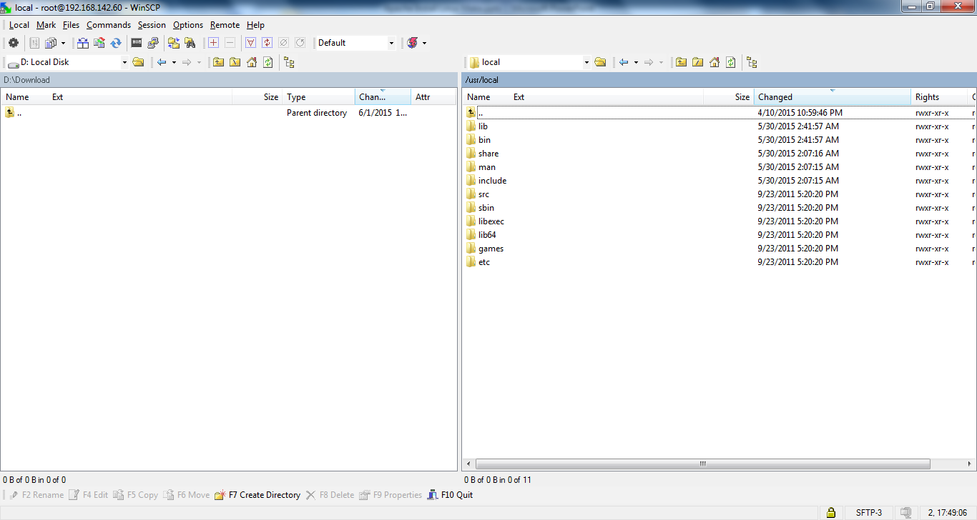
Apache Installation
Before install apache

Slide 2
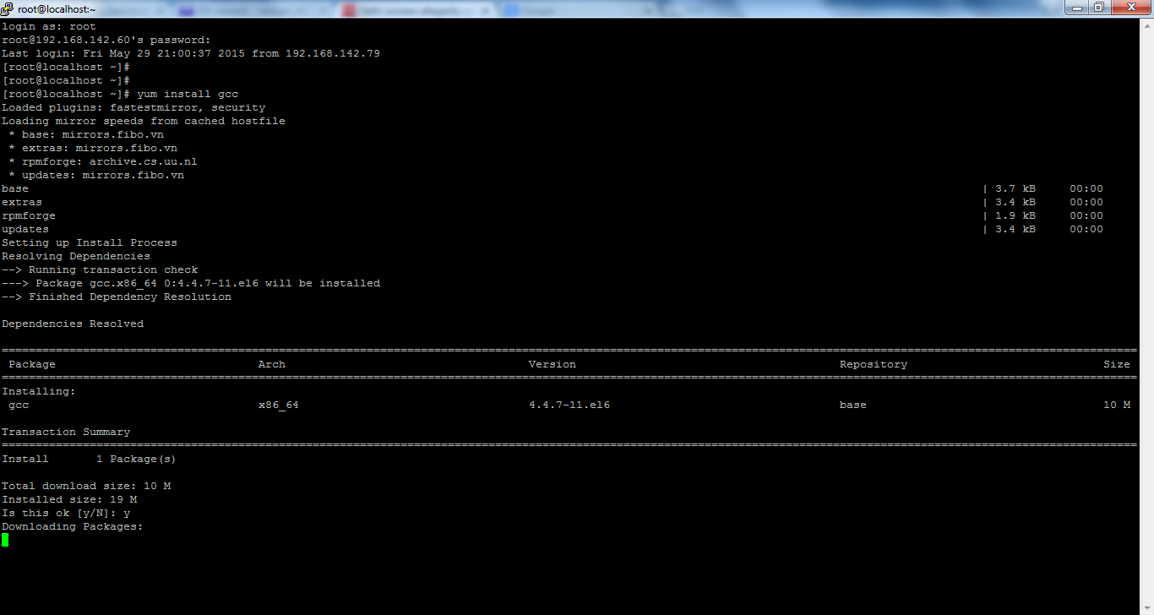
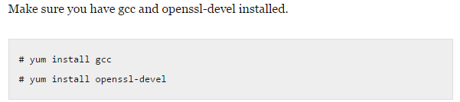
Apache Installation

Slide 3
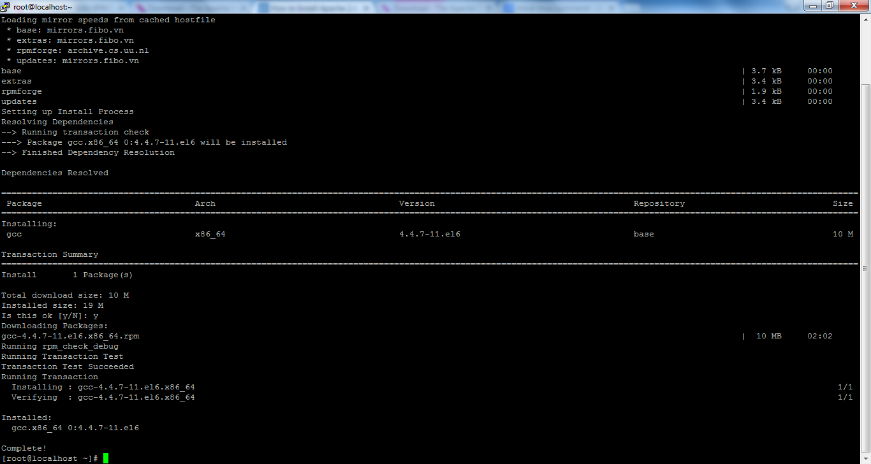
Apache Installation

Slide 4
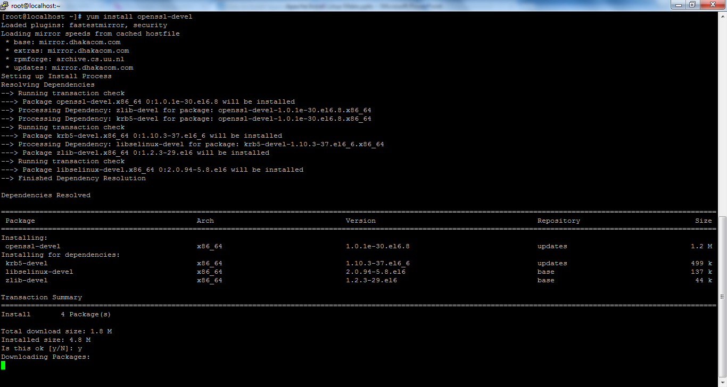
Apache Installation

Slide 5
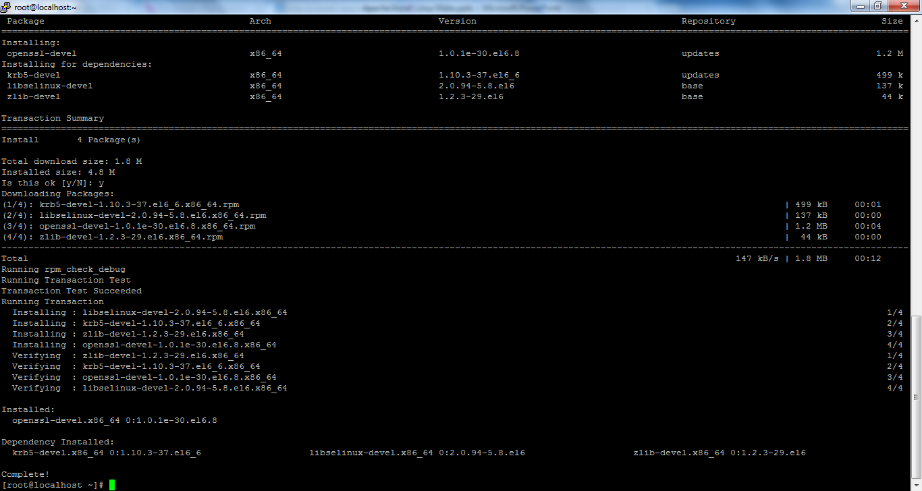
Apache Installation

Slide 6
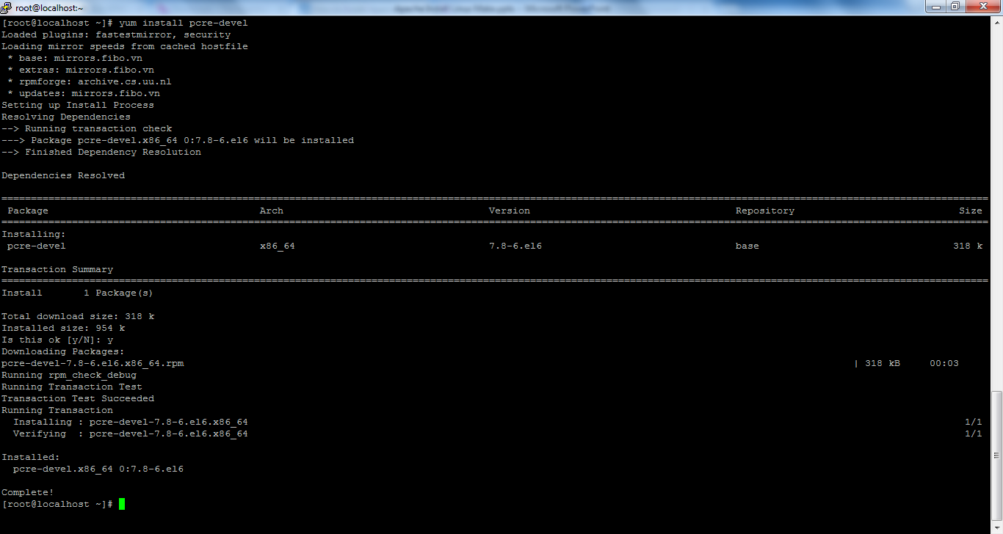
Apache Installation
Make sure you have pcre-devel is installed
# yum install pcre-devel

Slide 7
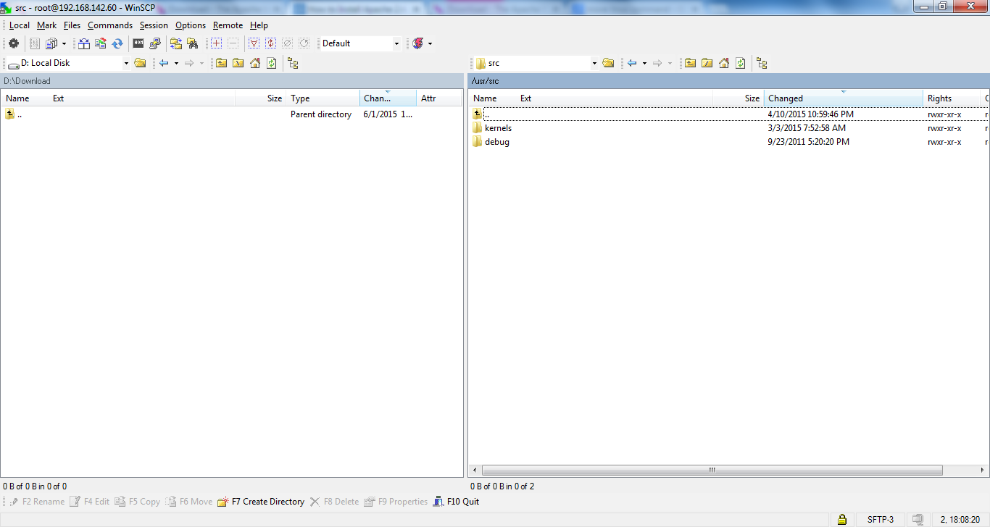
Apache Installation
/usr/src folder before downloading apache server related src tar files.

Slide 8
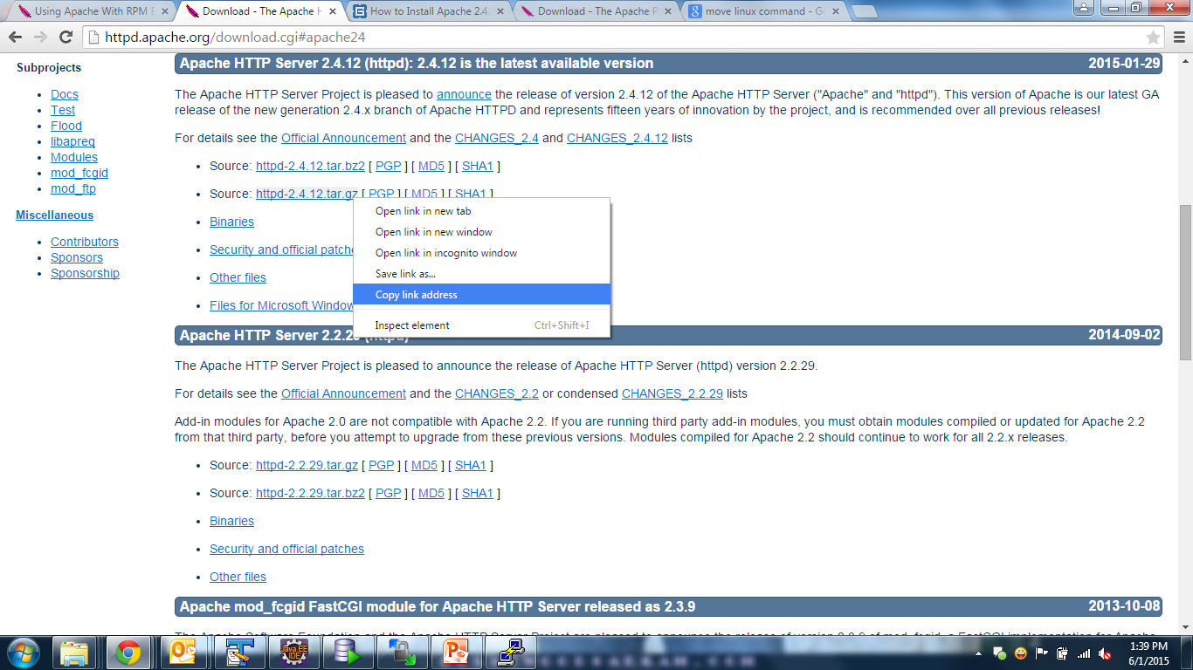
Apache Installation

Slide 9
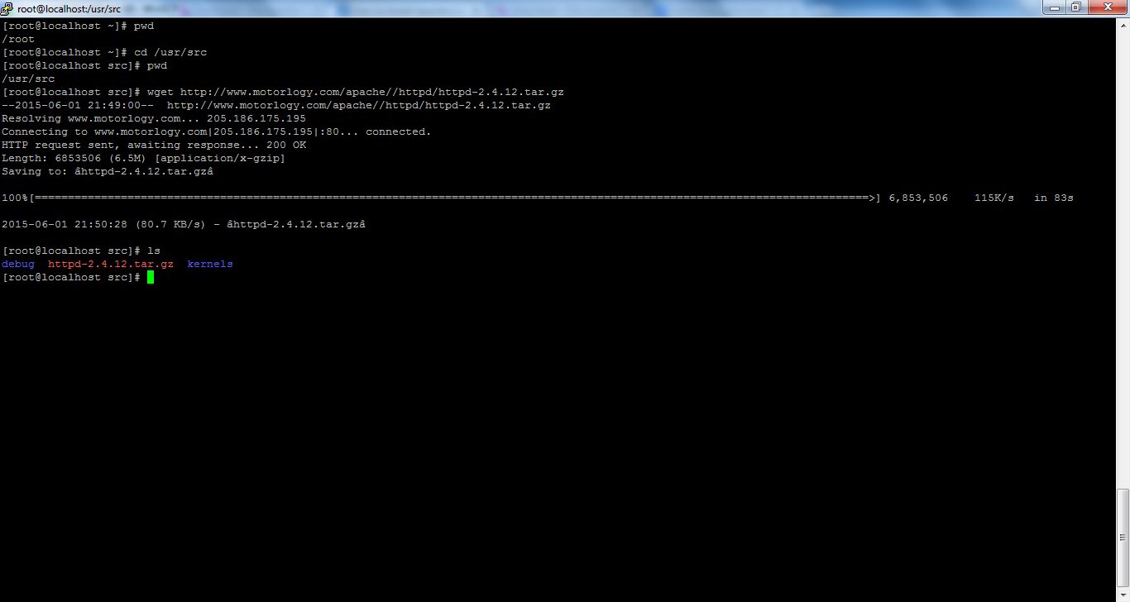
Apache Installation
# cd /usr/src
# wget http://www.motorlogy.com/apache//httpd/httpd-2.4.12.tar.gz
# tar xvfz httpd-2.4.12.tar.gz

Slide 10
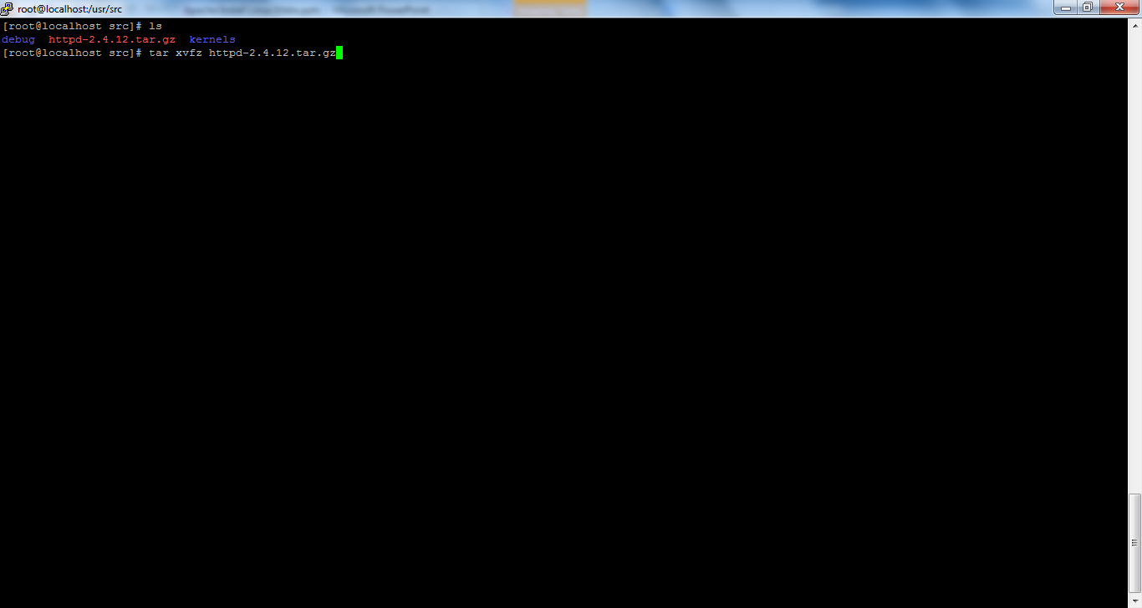
Apache Installation
# cd /usr/src
# wget http://www.motorlogy.com/apache//httpd/httpd-2.4.12.tar.gz
# tar xvfz httpd-2.4.12.tar.gz

Slide 11
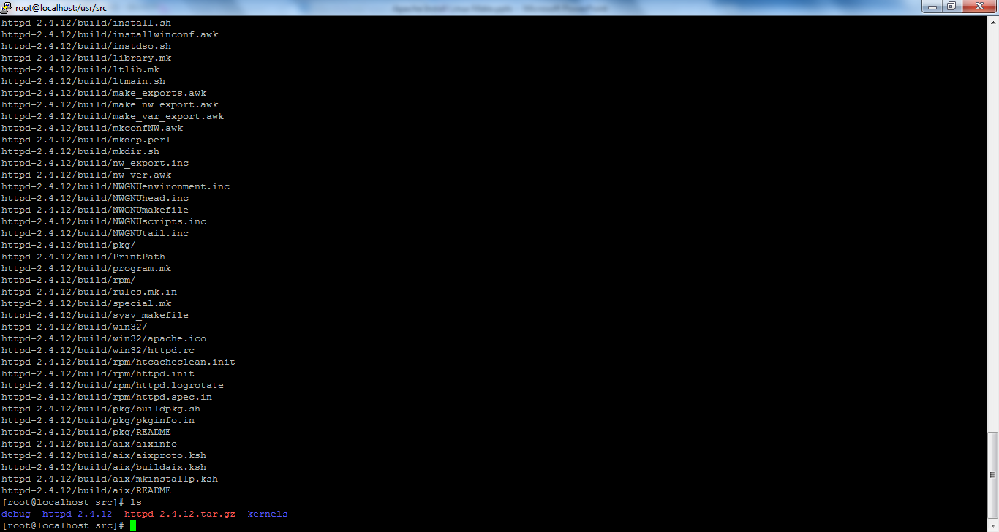
Apache Installation

Slide 12
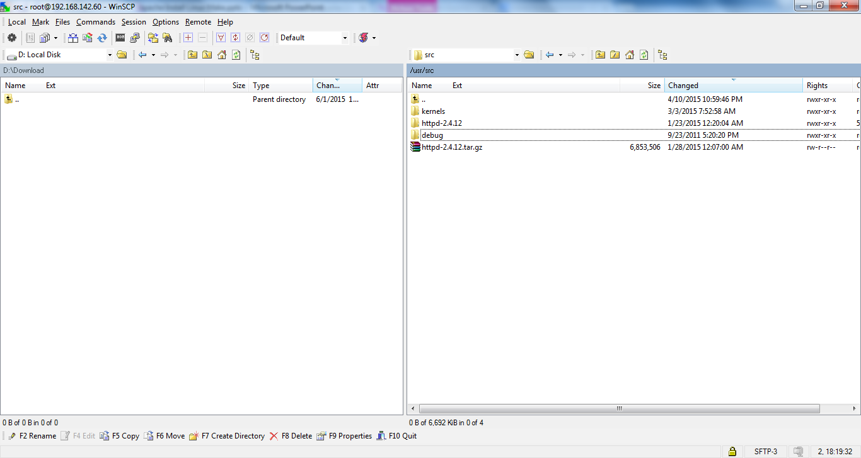
Apache Installation

Slide 13
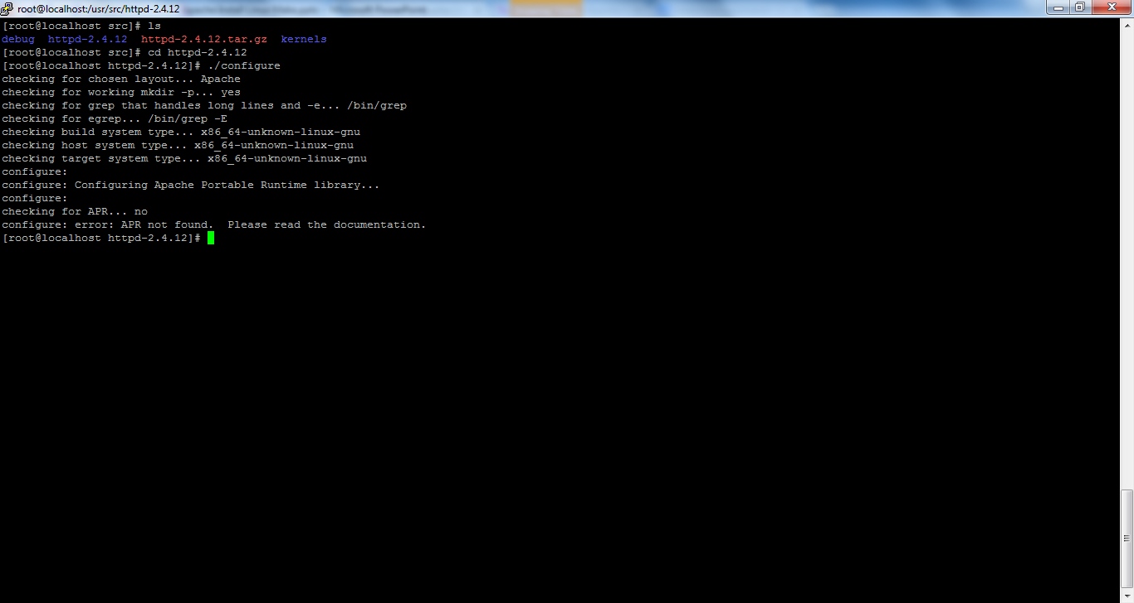
Apache Installation
# cd httpd-2.4.12
# ./configure
APR Not found error is coming we need to Fix this issue.

Slide 14
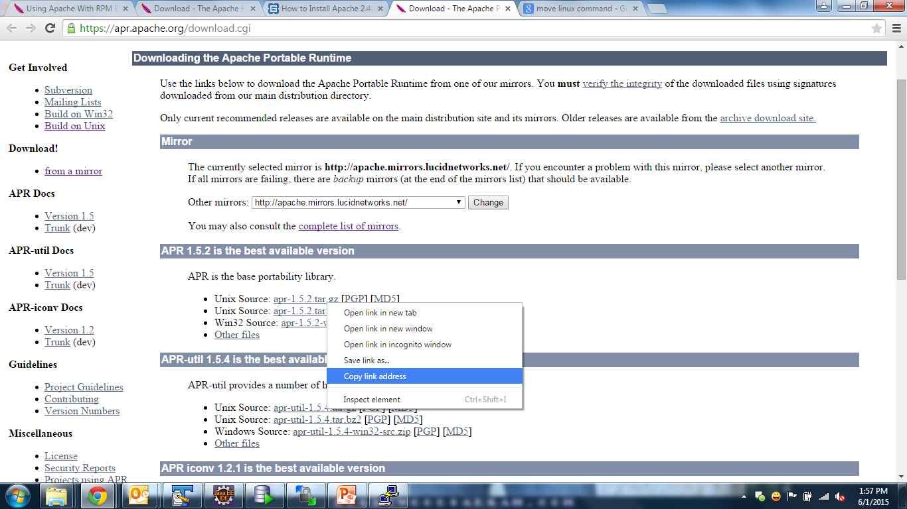
Apache Installation

Slide 15
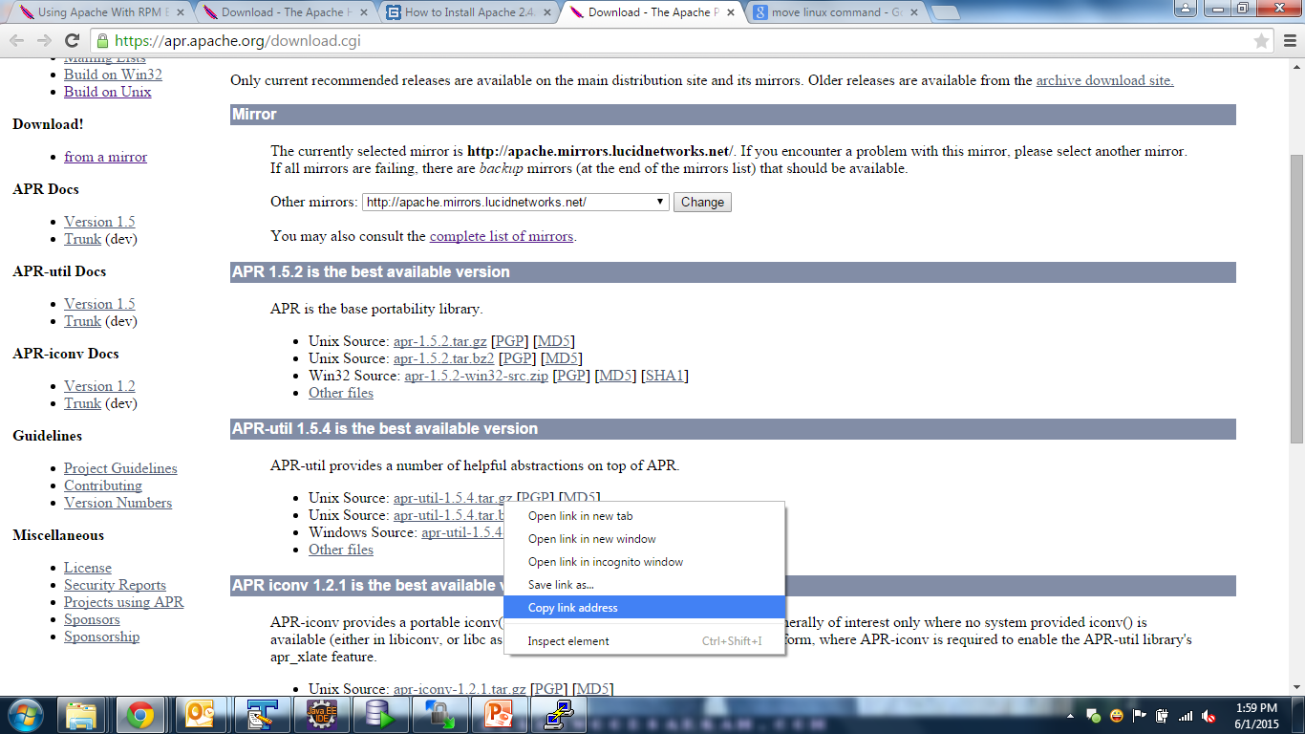
Apache Installation

Slide 16
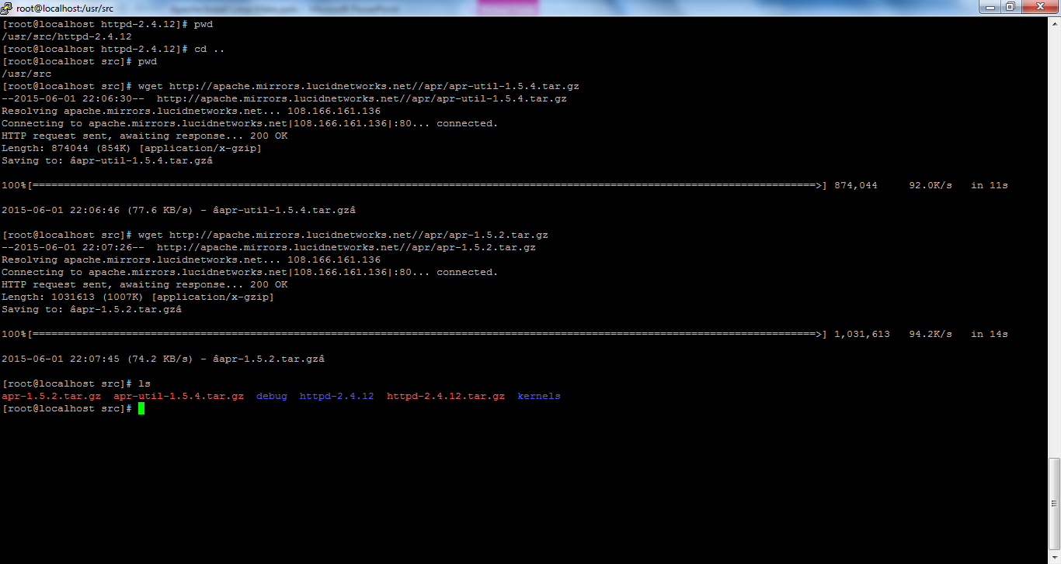
Apache Installation
Download APR and Extract
# cd /usr/src
# wget http://apache.mirrors.lucidnetworks.net//apr/apr-1.5.2.tar.gz
# wget http://apache.mirrors.lucidnetworks.net//apr/apr-util-1.5.4.tar.gz
# tar xvfz apr-1.5.2.tar.gz
# tar xvfz apr-util-1.5.4.tar.gz

Slide 17
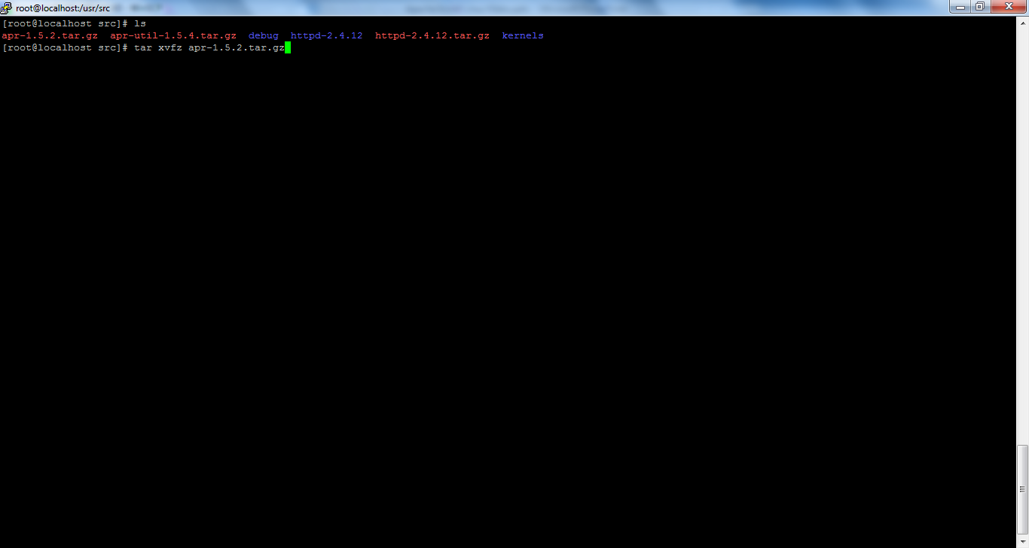
Apache Installation
Download APR and Extract
# cd /usr/src
# wget http://apache.mirrors.lucidnetworks.net//apr/apr-1.5.2.tar.gz
# wget http://apache.mirrors.lucidnetworks.net//apr/apr-util-1.5.4.tar.gz
# tar xvfz apr-1.5.2.tar.gz
# tar xvfz apr-util-1.5.4.tar.gz

Slide 18
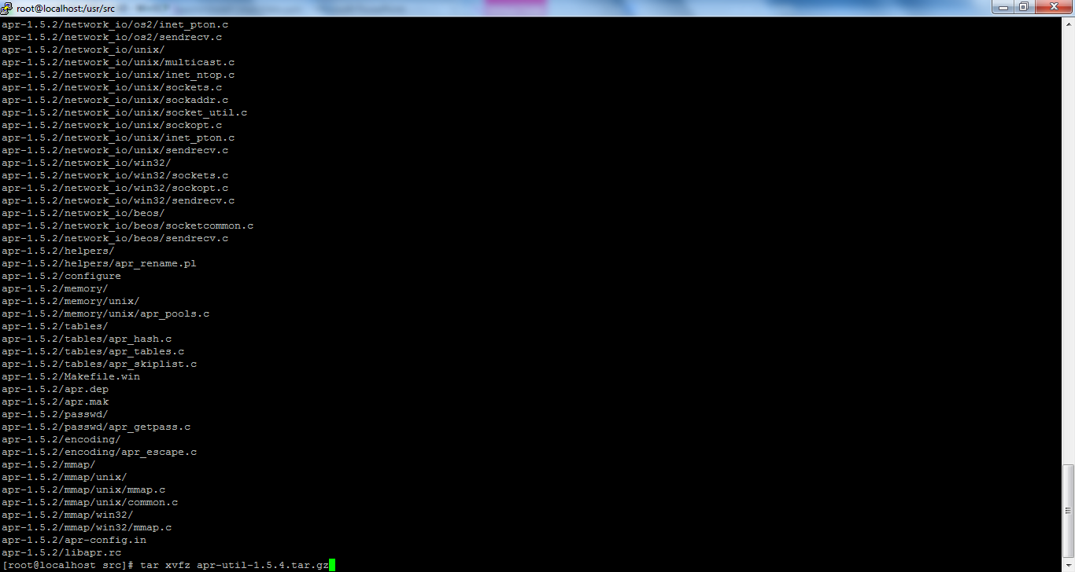
Apache Installation
Download APR and Extract
# cd /usr/src
# wget http://apache.mirrors.lucidnetworks.net//apr/apr-1.5.2.tar.gz
# wget http://apache.mirrors.lucidnetworks.net//apr/apr-util-1.5.4.tar.gz
# tar xvfz apr-1.5.2.tar.gz
# tar xvfz apr-util-1.5.4.tar.gz

Slide 19
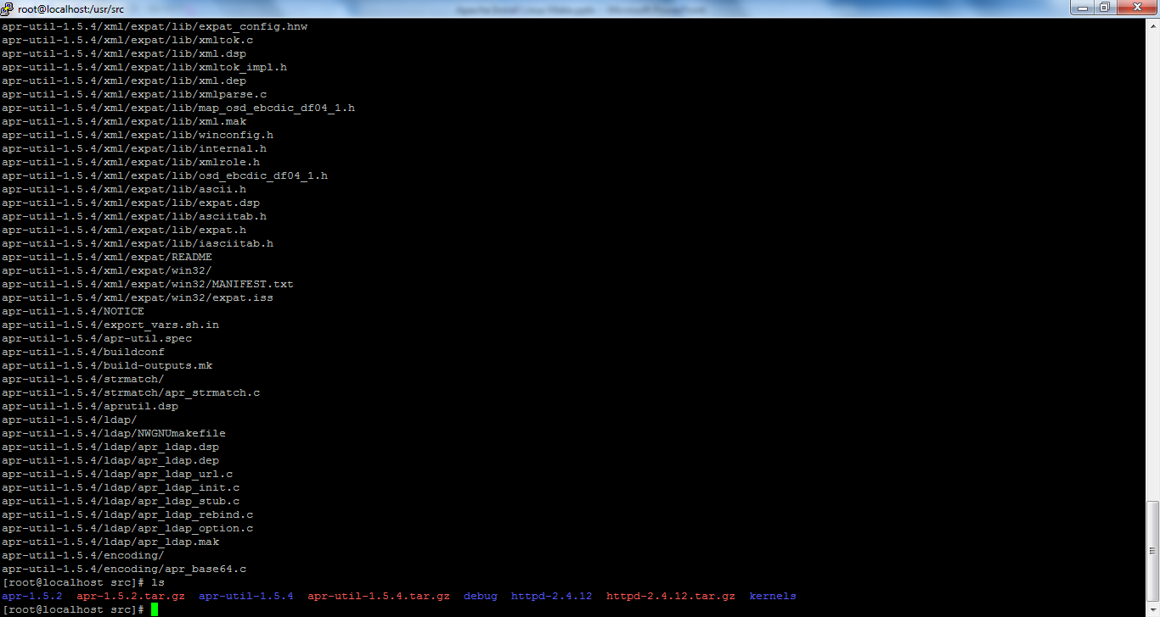
Apache Installation

Slide 20
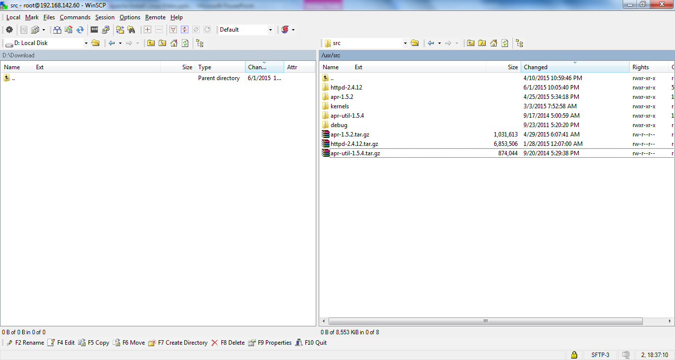
Apache Installation
/usr/src folder after downloading apache server related src tar files.

Slide 21
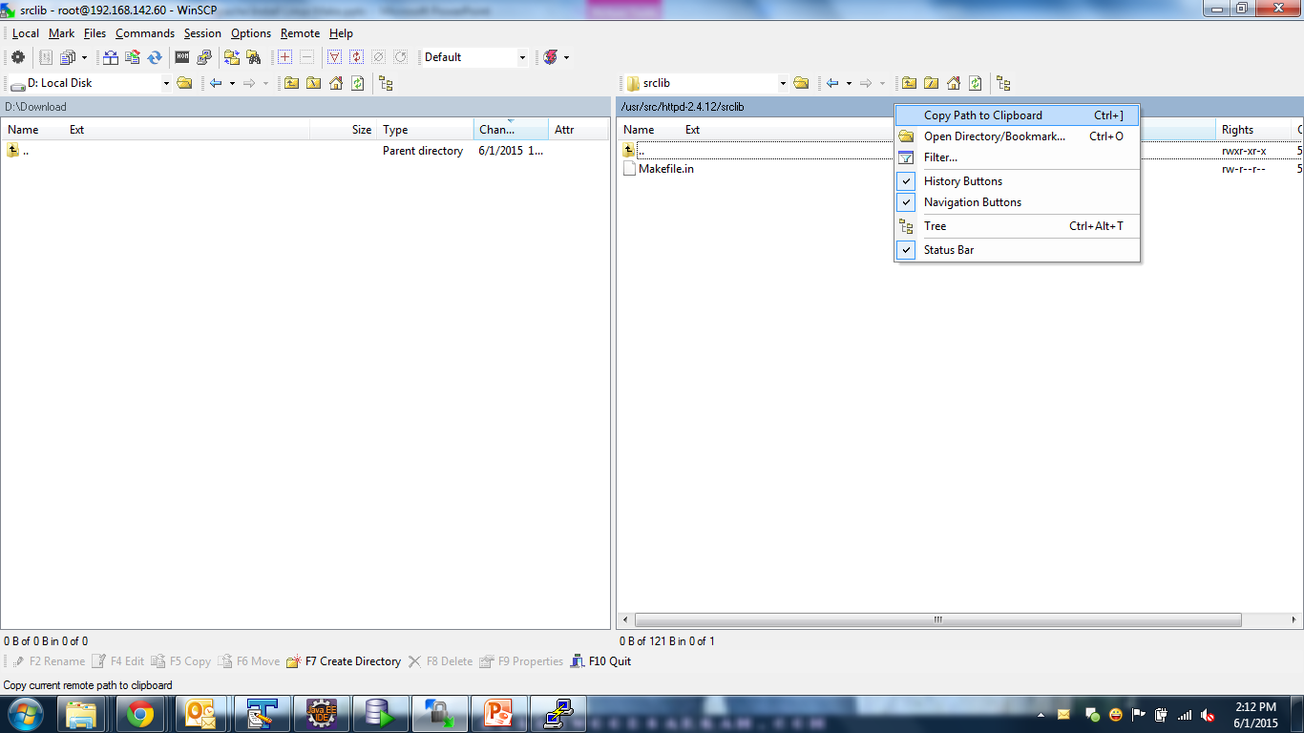
Apache Installation

Slide 22
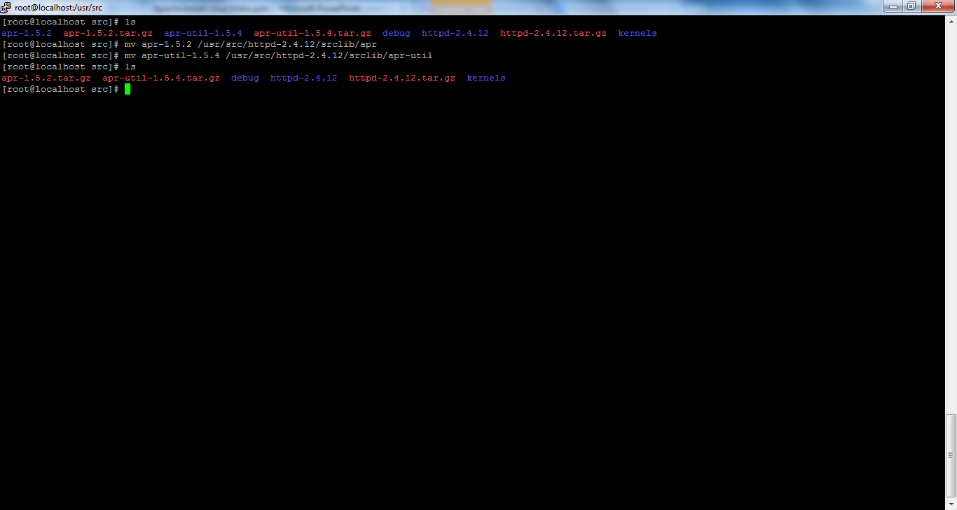
Apache Installation
Now, you should place this new version of apr and apr-util directories (without the version name in the directory)
under “srclib” directory located under the httpd-2.4.12 directory that was created
when you uncompressed the downloaded apache software.
# mv apr-1.5.2 /usr/src/httpd-2.4.12/srclib/apr
# mv apr-util-1.5.4 /usr/src/httpd-2.4.12/srclib/apr-util

Slide 23
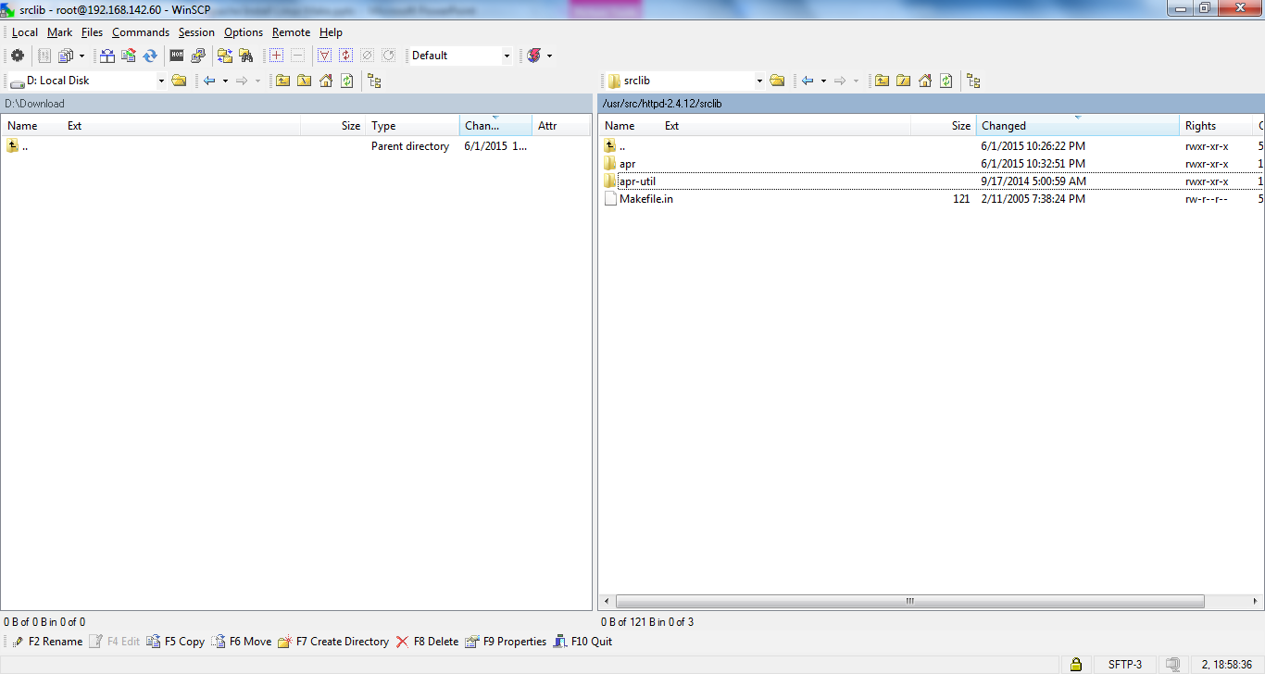
Apache Installation
After move of apr-1.5.2 and apr-util-1.5.4

Slide 24
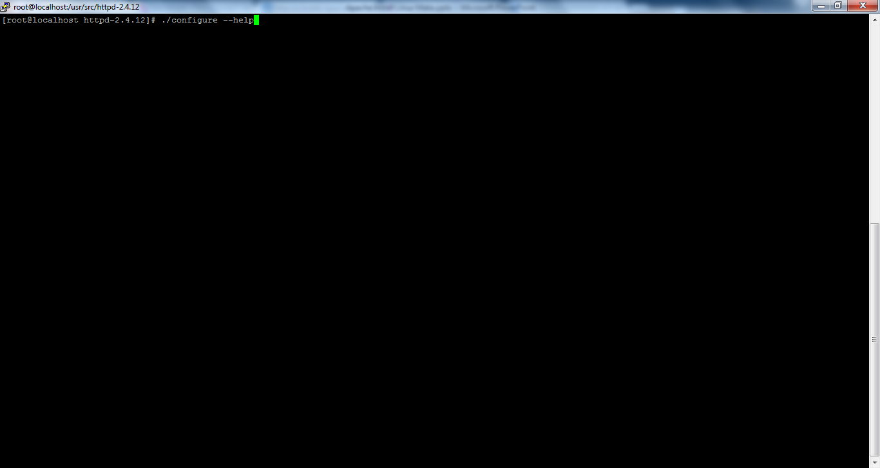
Apache Installation
# ./configure --help

Slide 25
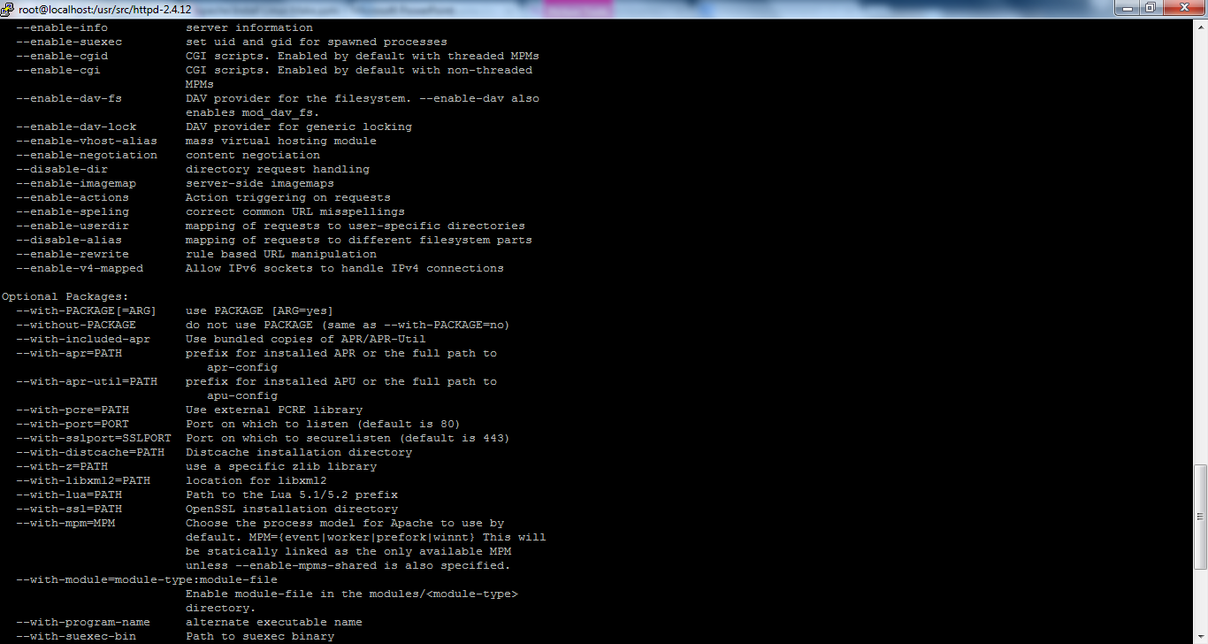
Apache Installation
If you decide to install the apr-1.4.6 and apr-util-1.4.1 on your system, you need to use “–with-apr” and “–with-apr-util” and provide the path where you installed these utility.
In this example, we didn’t do that. i.e We didn’t install the apr and apr-util
that we downloaded. Instead we placed them under
the /httpd-2.4.12/srclib/apr-util. So, we should use “–with-included-apr” in
the ./configure which will use these apr and apr-util only for the apache compilation
and installation.

Slide 26
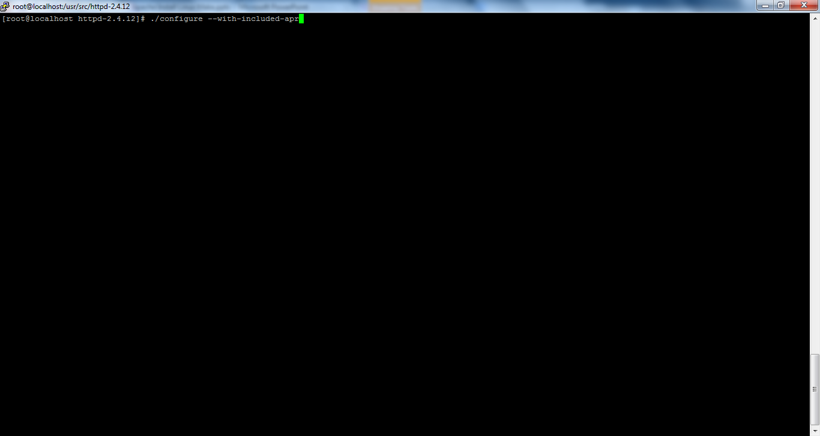
Apache Installation
# ./configure --with-included-apr

Slide 27
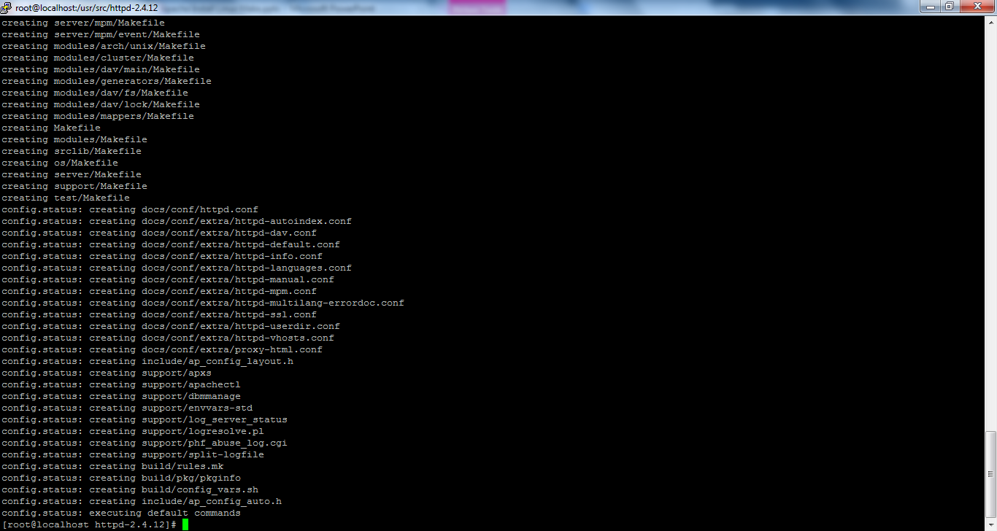
Apache Installation
# ./configure --with-included-apr

Slide 28
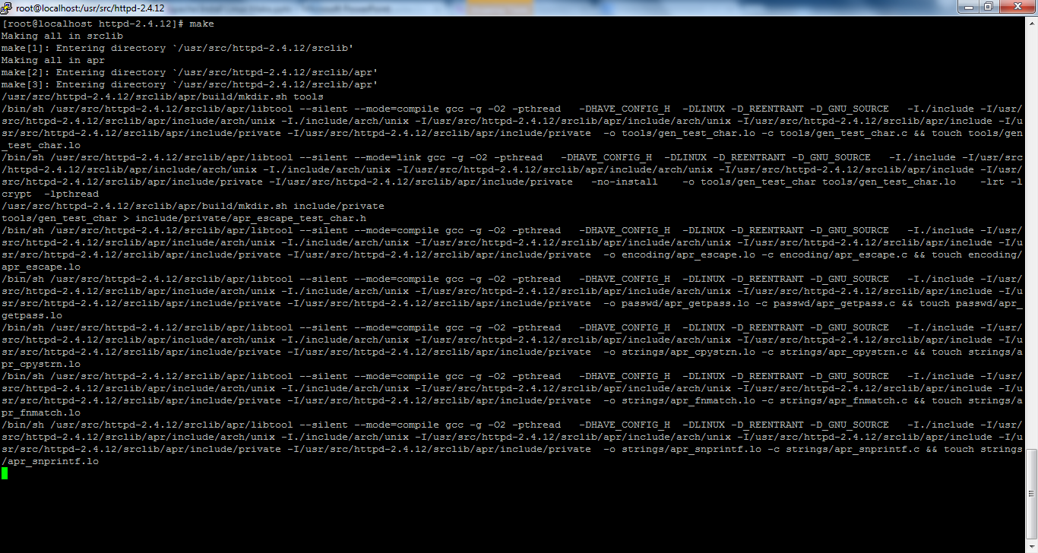
Apache Installation
# make

Slide 29
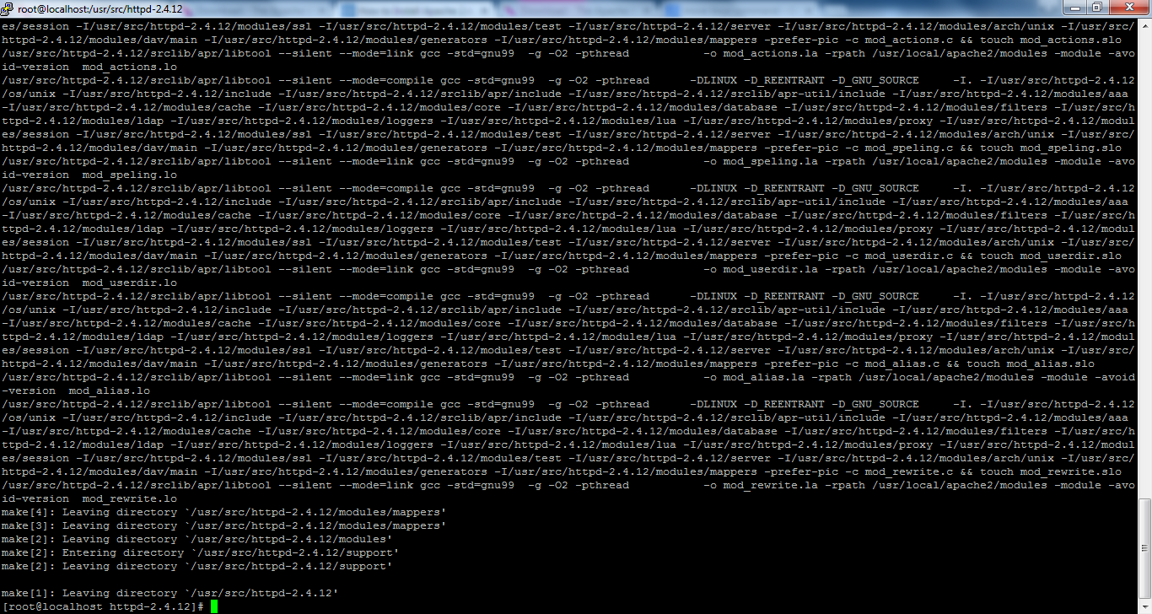
Apache Installation
make process is completed.

Slide 30
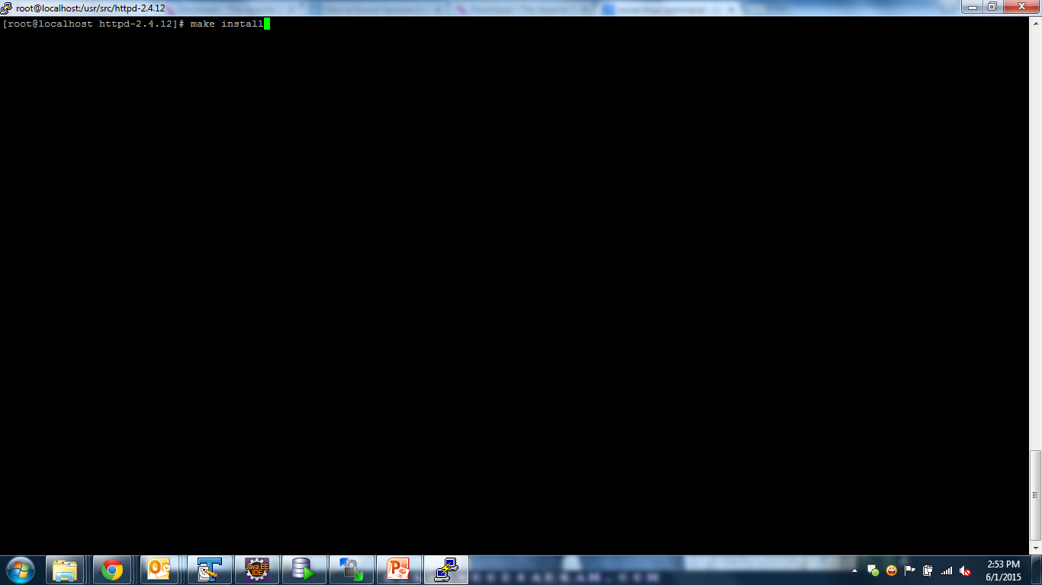
Apache Installation
# make install

Slide 31
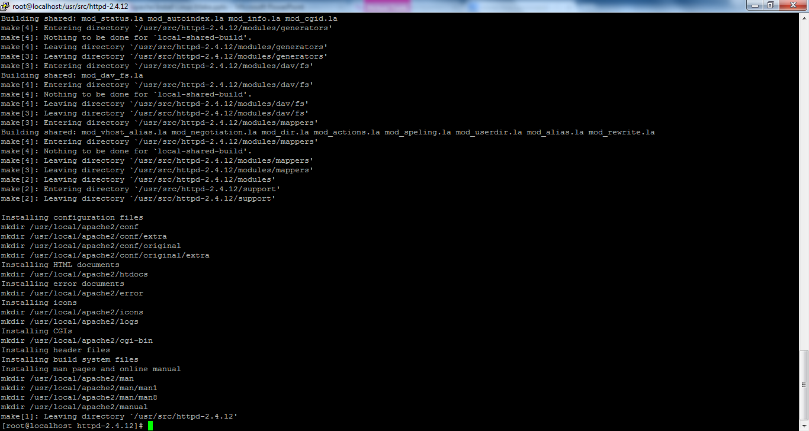
Apache Installation
make install is completed [i.e. apache has been successfully installed.]

Slide 32
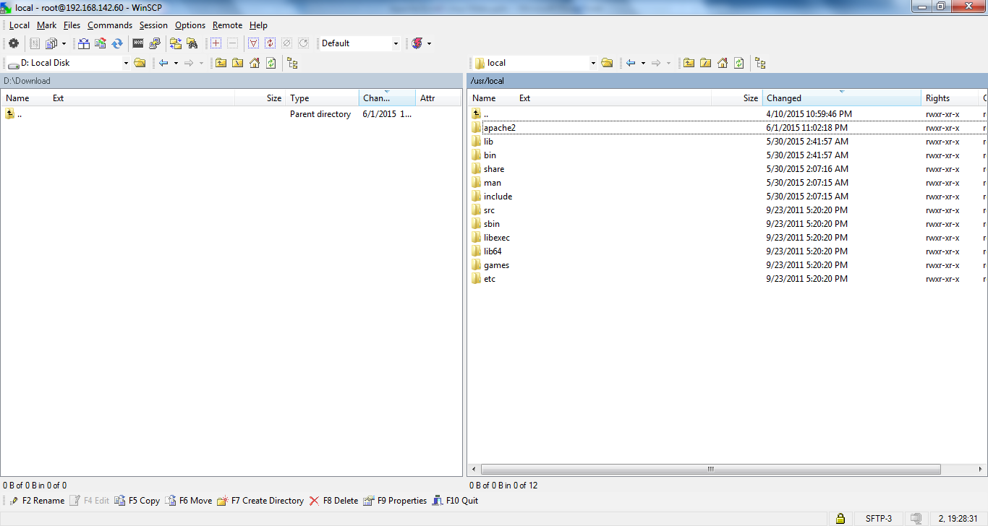
Apache Installation
make install is completed [i.e. apache has been successfully installed.]

Slide 33
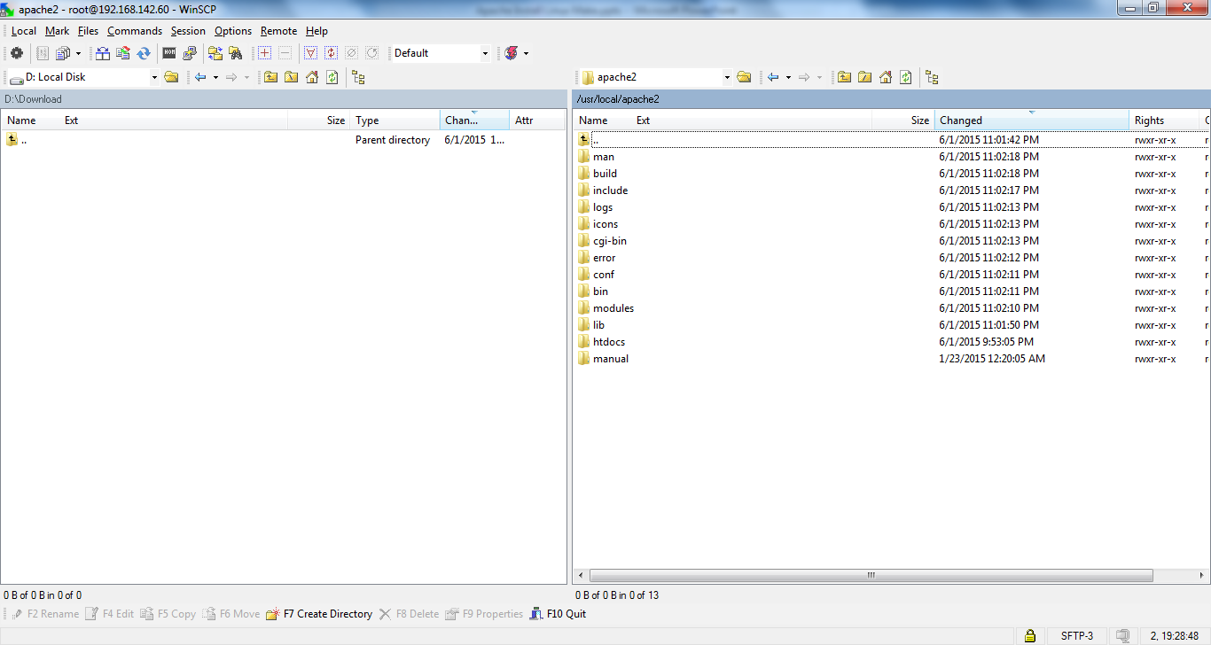
Apache Installation

Slide 34
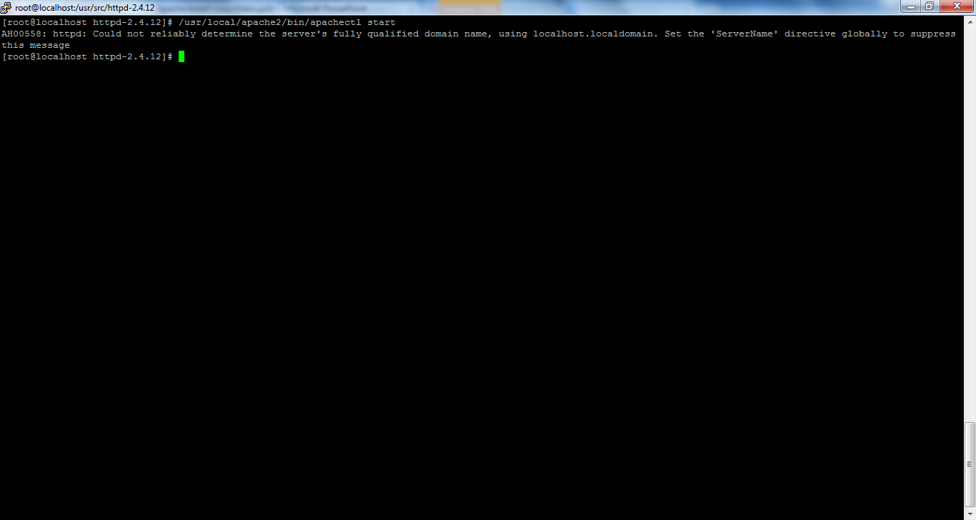
Apache Installation
Start,Stop and Restart Apache server
# /usr/local/apache2/bin/apachectl start
# /usr/local/apache2/bin/apachectl stop
# /usr/local/apache2/bin/apachectl restart

Slide 35
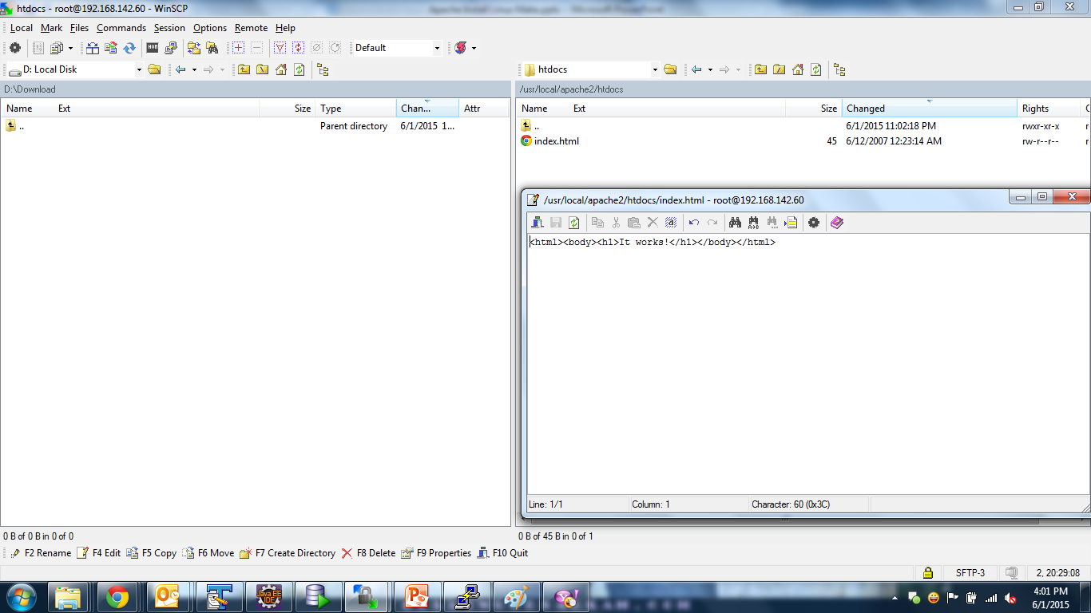
Apache Installation

Slide 36
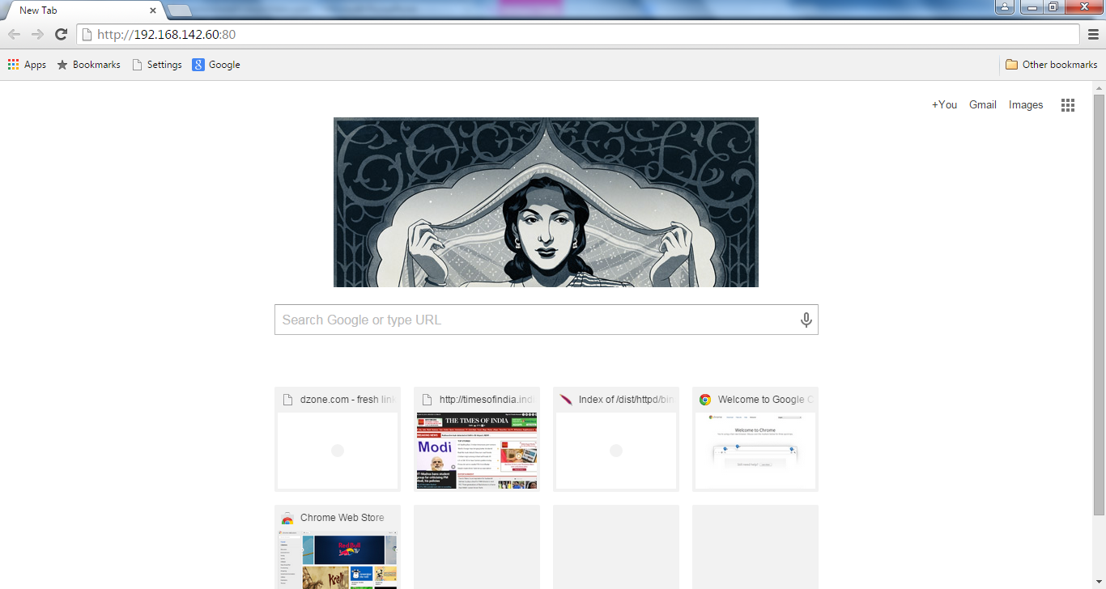
Apache Installation
Enter url and press enter

Slide 37
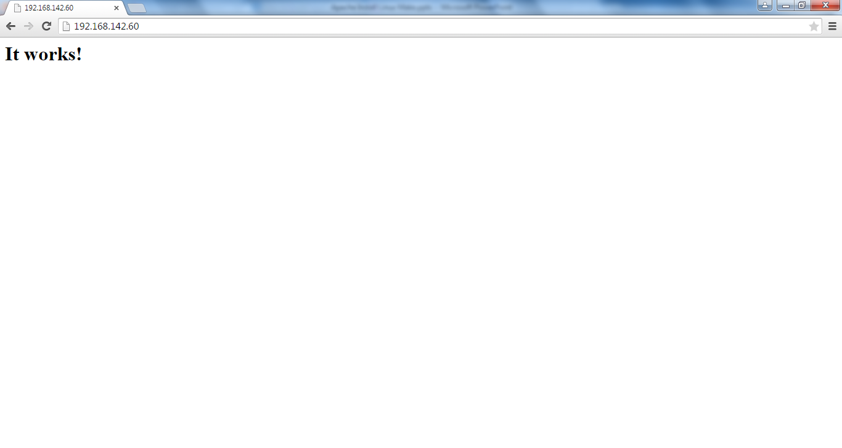
Apache Installation
Welcome page[i.e. Index.html] is working.

Slide 38
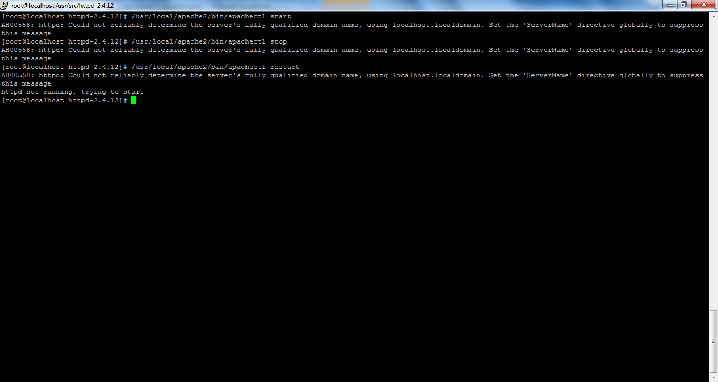
Apache Installation
Start,Stop and Restart the Apache server
# /usr/local/apache2/bin/apachectl start
# /usr/local/apache2/bin/apachectl stop
# /usr/local/apache2/bin/apachectl restart

Slide 39
Apache Uninstall
# yum install gcc
# yum install openssl-devel
# yum install pcre-devel
http://httpd.apache.org/download.cgi
http://httpd.apache.org/download.cgi#apache24
# cd /usr/src
# wget http://www.motorlogy.com/apache//httpd/httpd-2.4.12.tar.gz
# tar xvfz httpd-2.4.12.tar.gz
# cd httpd-2.4.12
# ./configure
https://apr.apache.org/download.cgi
# cd /usr/src
# wget http://apache.mirrors.lucidnetworks.net//apr/apr-1.5.2.tar.gz
# wget http://apache.mirrors.lucidnetworks.net//apr/apr-util-1.5.4.tar.gz
# tar xvfz apr-1.5.2.tar.gz
# tar xvfz apr-util-1.5.4.tar.gz
# mv apr-1.5.2 /usr/src/httpd-2.4.12/srclib/apr
# mv apr-util-1.5.4 /usr/src/httpd-2.4.12/srclib/apr-util

Slide 40
Apache Uninstall
# ./configure --help
# ./configure --with-included-apr
# make
# make install
# /usr/local/apache2/bin/apachectl start
# /usr/local/apache2/bin/apachectl stop
# /usr/local/apache2/bin/apachectl restart

Slide 41
Apache Uninstall
http://httpd.apache.org/docs/2.4/platform/rpm.html
http://httpd.apache.org/download.cgi#apache24
http://www.erikwebb.net/blog/compile-and-install-apache-24-red-hat-enterprise-linux-rhel-6-or-centos-6/
http://howtolamp.com/lamp/httpd/2.4/installing-httpd-dependencies/
http://www.thegeekstuff.com/2012/05/install-apache-2-on-centos-6/
http://www.cyberciti.biz/faq/apachehttpdaddress-already-in-use-make_sock-could-not-bind-to-port-80-or-443/
http://serverfault.com/questions/589831/how-do-i-remove-apache-if-i-installed-it-from-the-source-tarball

Slide 42
Apache Uninstall
error: Failed build dependencies:
zlib-devel is needed by httpd-2.4.12-1.x86_64
libselinux-devel is needed by httpd-2.4.12-1.x86_64
libuuid-devel is needed by httpd-2.4.12-1.x86_64
apr-devel >= 1.4.0 is needed by httpd-2.4.12-1.x86_64
apr-util-devel >= 1.4.0 is needed by httpd-2.4.12-1.x86_64
pcre-devel >= 5.0 is needed by httpd-2.4.12-1.x86_64
lua-devel is needed by httpd-2.4.12-1.x86_64
libxml2-devel is needed by httpd-2.4.12-1.x86_64
distcache-devel is needed by httpd-2.4.12-1.x86_64
openssl-devel is needed by httpd-2.4.12-1.x86_64
[root@localhost work]#
yum install zlib-devel
Yum erase zlib-devel

